Slide 1
VCO schematic Part 1 5~10GHz range

Slide 2
Achevements
Frequency range: 9.73GHz~1.71GHz
Amplitute control: 0.2~0.5V differential
second harmonic (best case): -60dB
third harmonic (best case): -60dB
settling time:6ns(max)
startup time:48ns(max)

Slide 3
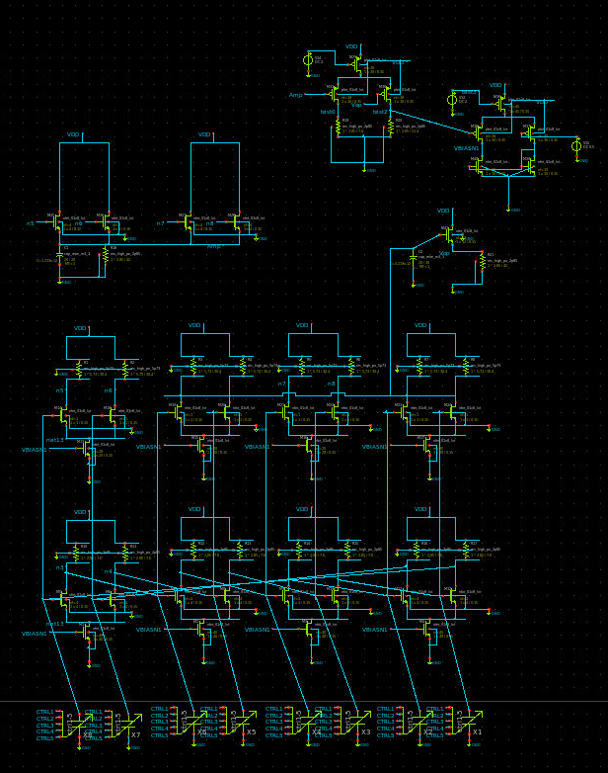
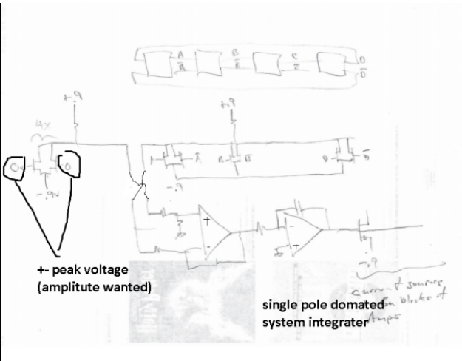
Schematic
Consists of core oscillator and amplitute feedback. Able to alter output differential amplitute with external voltage sources.

Slide 4
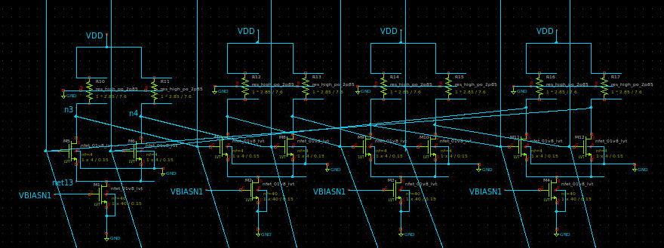
Core oscillator
Take input from feedback network to modify amplitute
Capable to genreate sinwave of frequency from 9.734GHz~1.71GHz

Slide 5
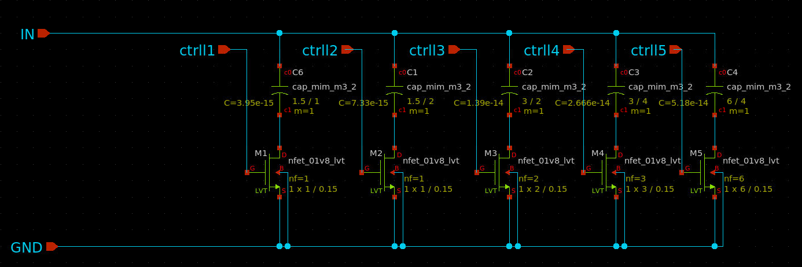
Capacitor bank
Binary weighted capacitor bank
Optimized for minimum on capacitance
Five bit control

Slide 6
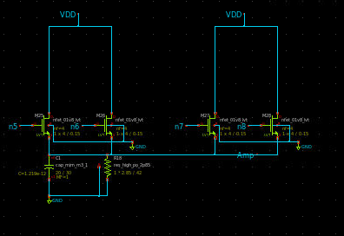
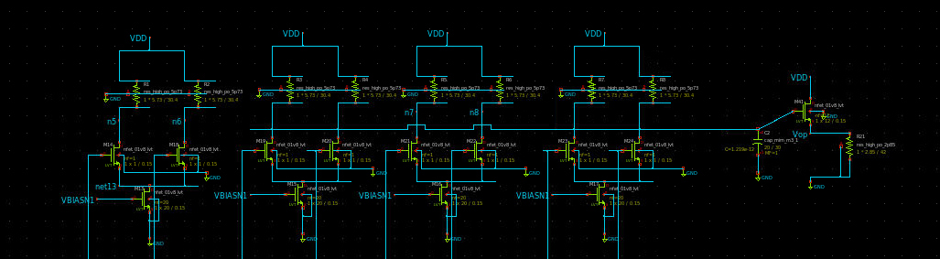
peak and operating point detect
Pick up peak and operating point. Calculate amplitute level

Slide 7
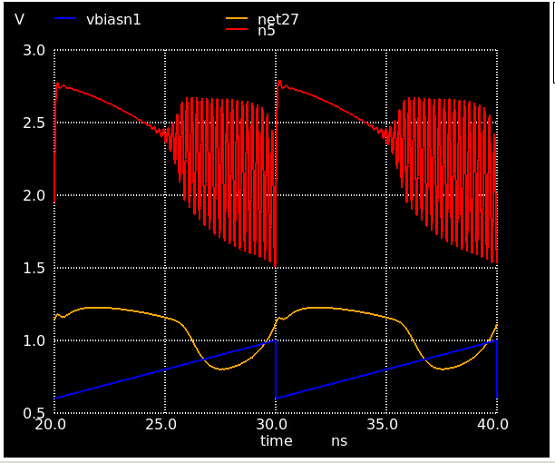
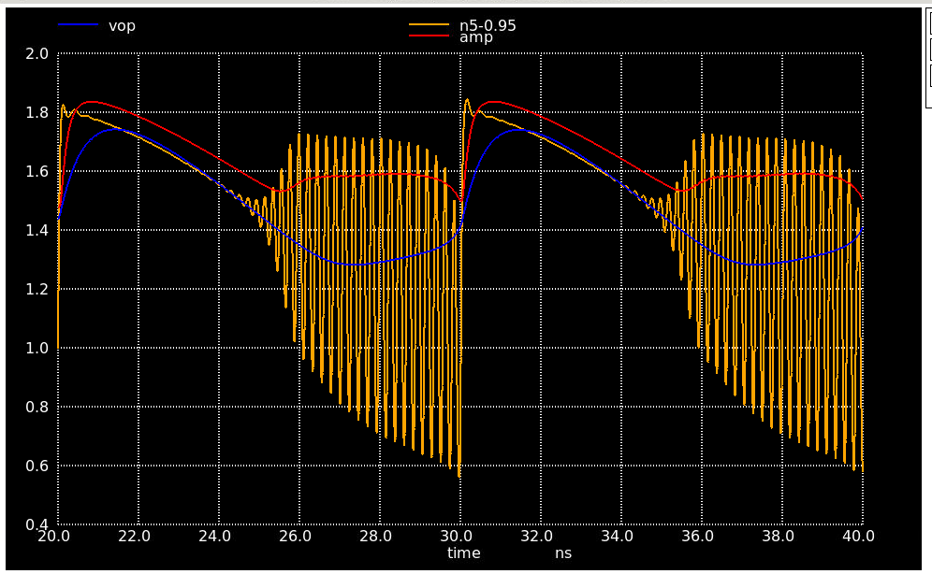
Peak and operating point plot
Feedback open loop on the left (net27 connect to vbiasn1 in close loop)
vop amp depicking the amplitute and operating point of oscillation

Slide 8
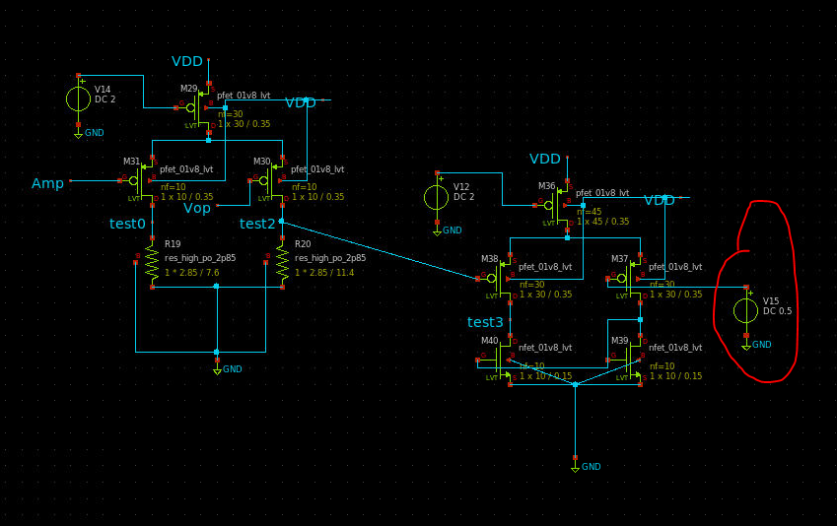
feedback
amplitute level control by voltage on V15
V15 voltage range: 0.25~0.45V
Can actually control amplitute of differentail output

Slide 9
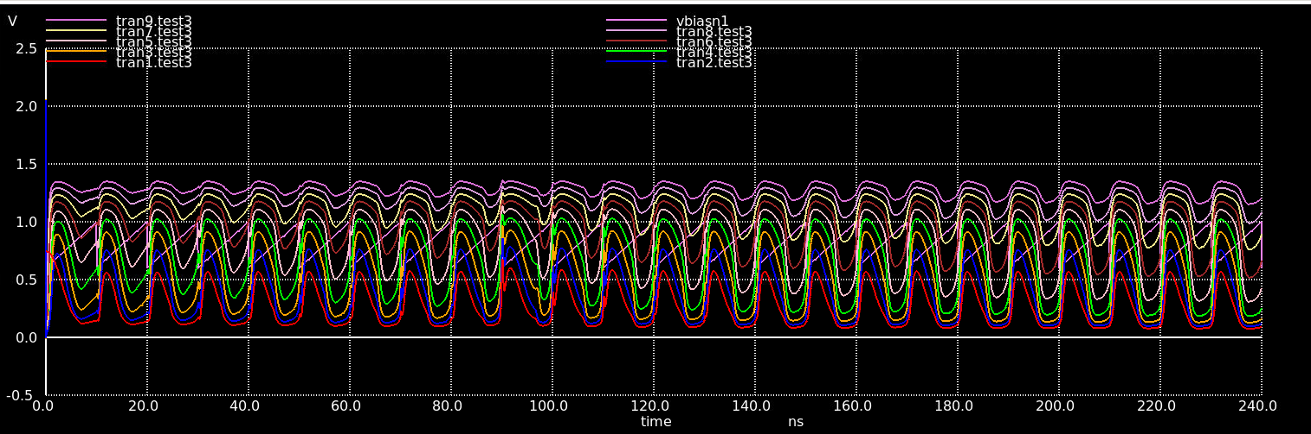
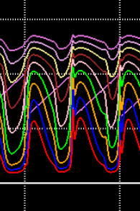
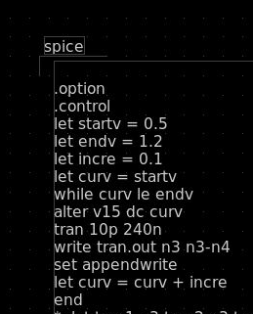
Feedback open loop result
Tran number | V15 control voltage
1 | 0.2V
2 | 0.25V
3 | 0.3V
4 | 0.35V
5 | 0.4V
6 | 0.45V
7 | 0.5V
8 | 0.55V
9 | 0.6V

Slide 10
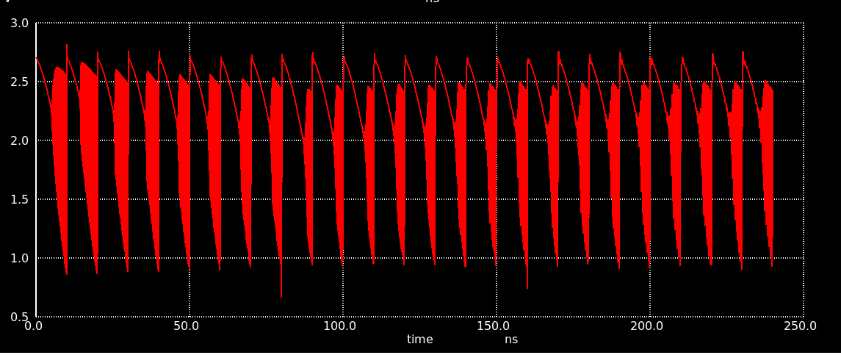
Feed amplitute map graph
Feedback loop stable at vbiasn1 cross test3
map below to find oscillation amplitute

Slide 11
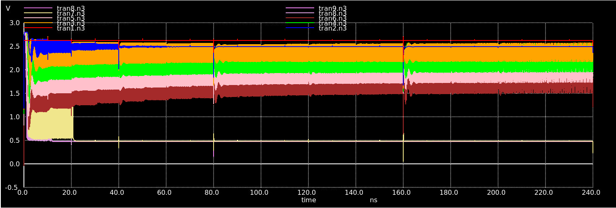
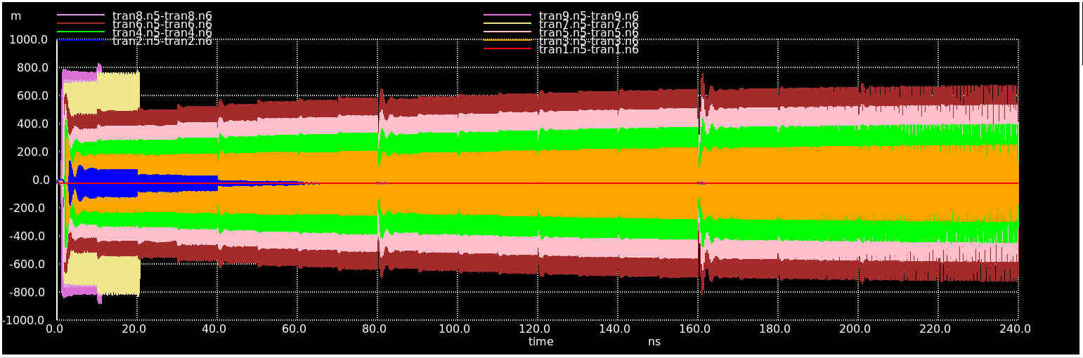
Amplitute control
V15 control voltage | Differential Amplitute
0.2V | not exist
0.25V | ~0V
0.3V | 0.2V
0.35V | 0.3V
0.4V | 0.4V
0.45V | 0.45~0.5V
0.5V | not stable
0.55V | not stable
0.6V | not stable
amplitute level control by voltage on V12
V15 voltage range:
Core oscillator, single ended
output buffer, differential

Slide 12
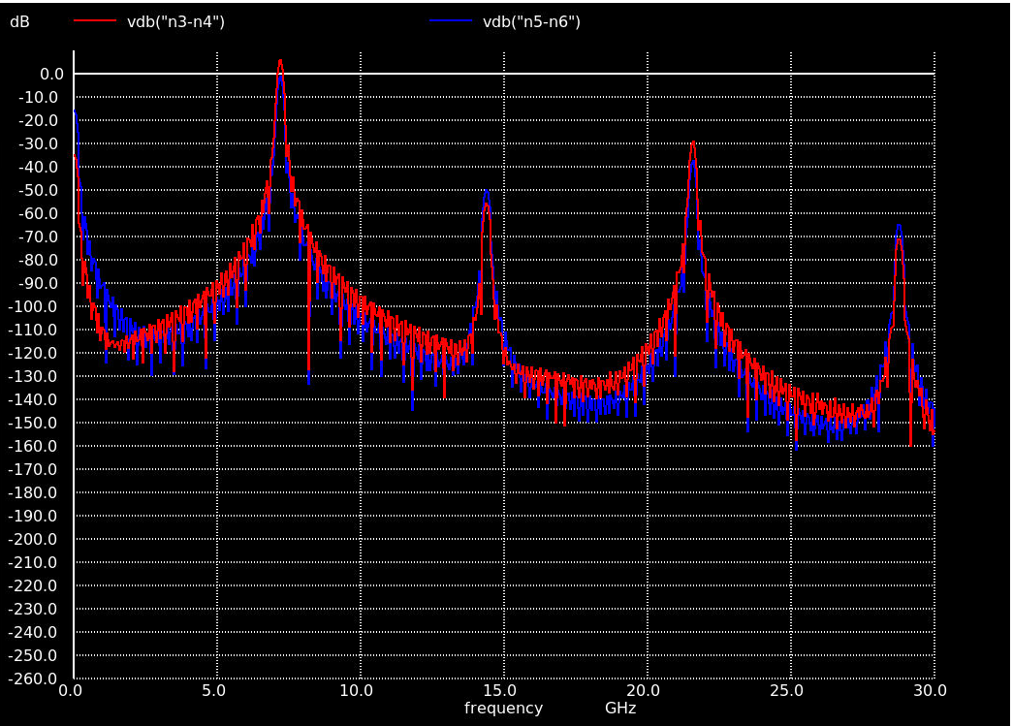
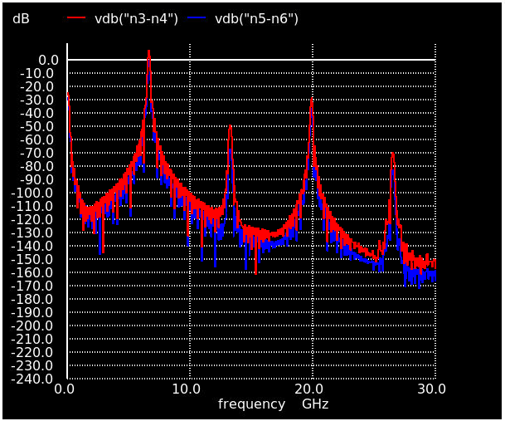
Effect of amplitute control at 6.23G no obvious effect when amplitute large
control voltage = 0.45V
control voltage = 0.4V

Slide 13
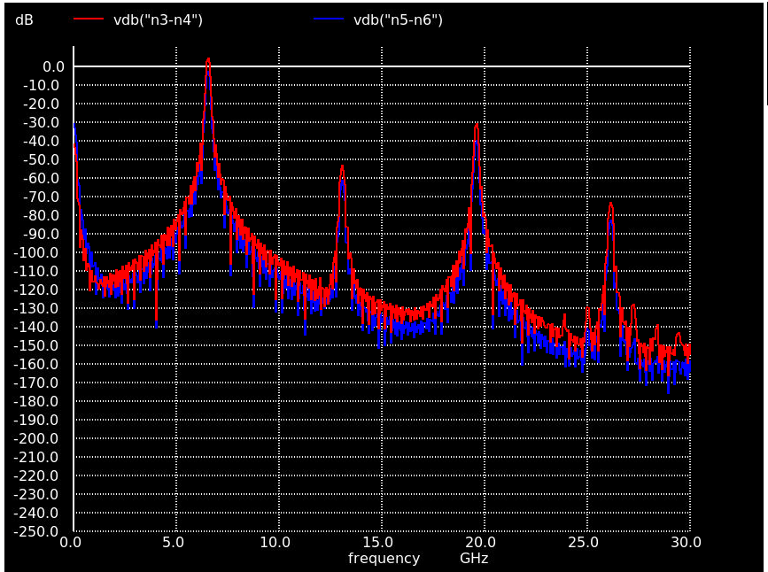
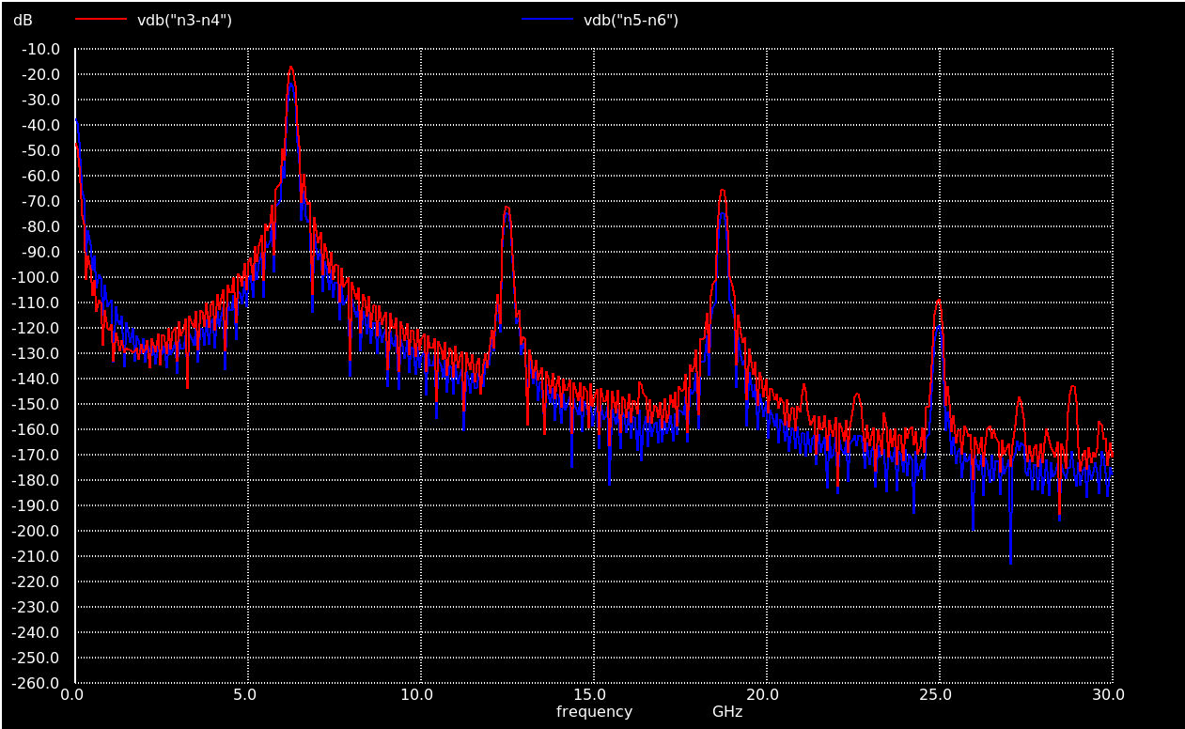
Effect of amplitute control at 6.23G high frequency component decay obviously when amplitute get smaller
control voltage = 0.35V
control voltage = 0.3V

Slide 14
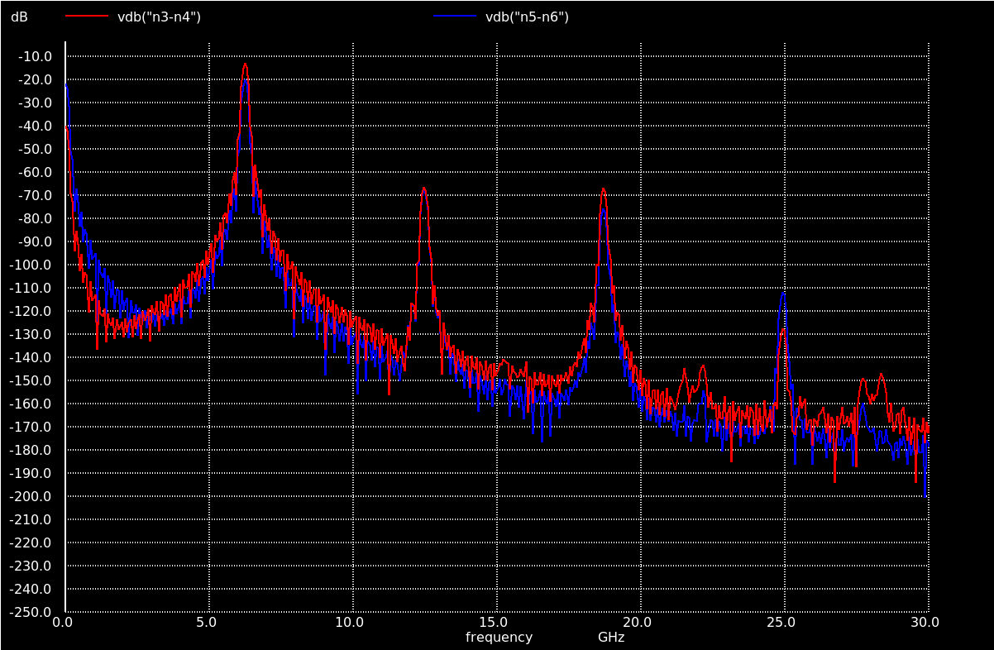
effect of Amplitute control - lowest amplitute at 6.23G
Minimum amplitute ctrl = 0.27V

Slide 15
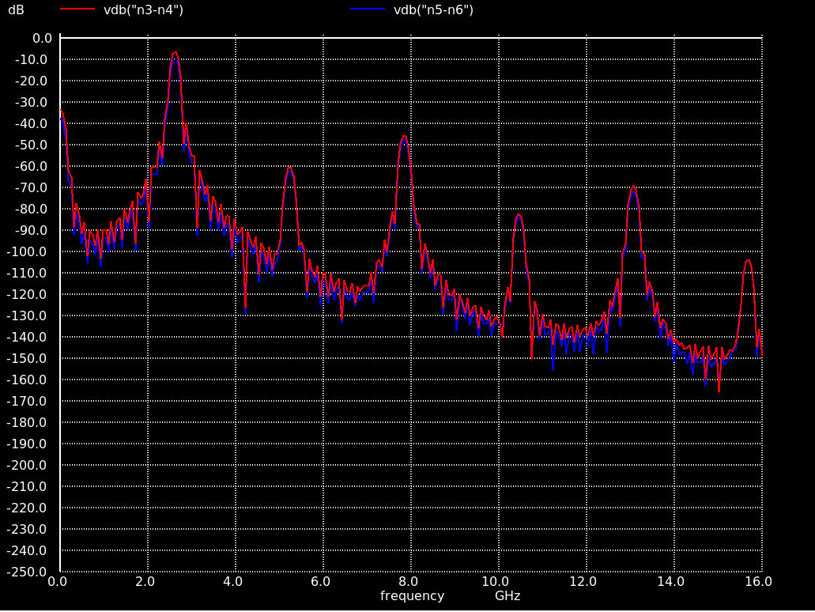
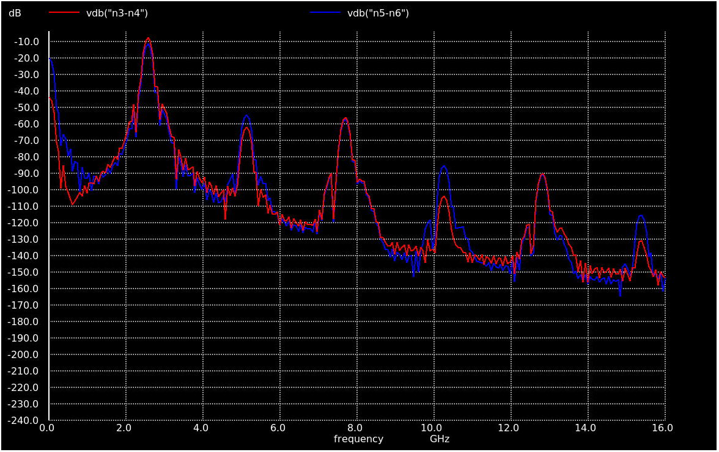
effect of Amplitute control - lowest amplitute at 2.64G
control voltage 0.40V
control voltage 0.3V

Slide 16
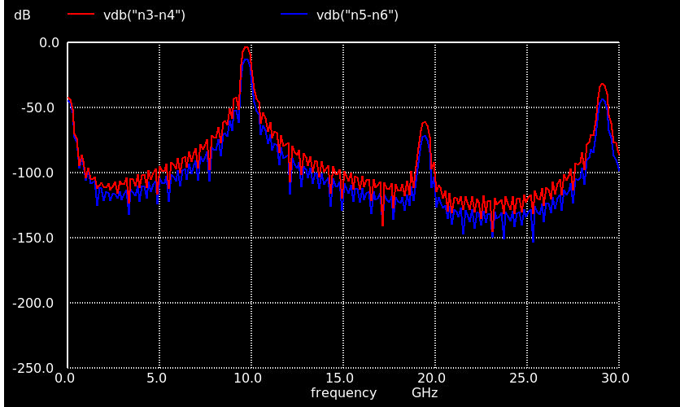
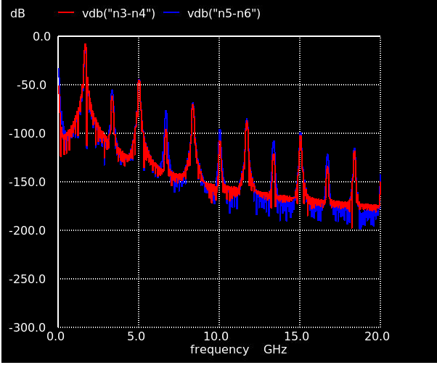
Frequency range vctrl=0.5
Frequency 9.37GHz (max)
Capacitor bank switch off
Frequence: 1.71GHz (min)
Capacitor bank switch on

Slide 17
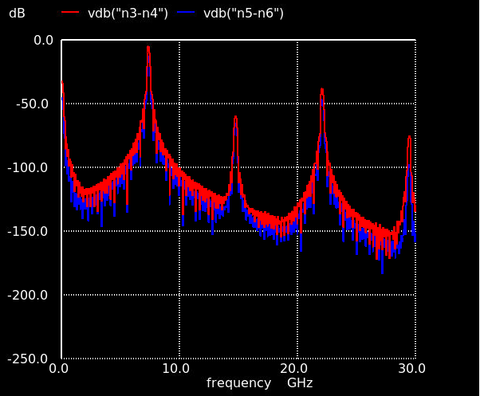
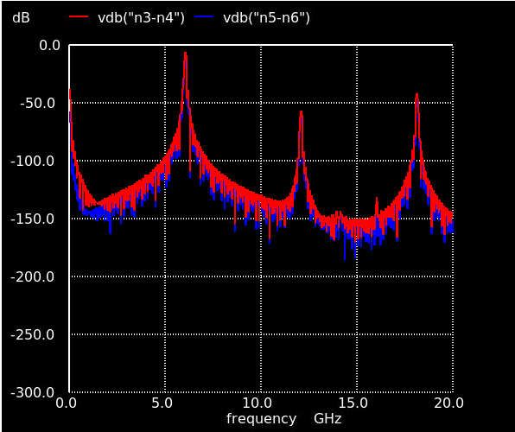
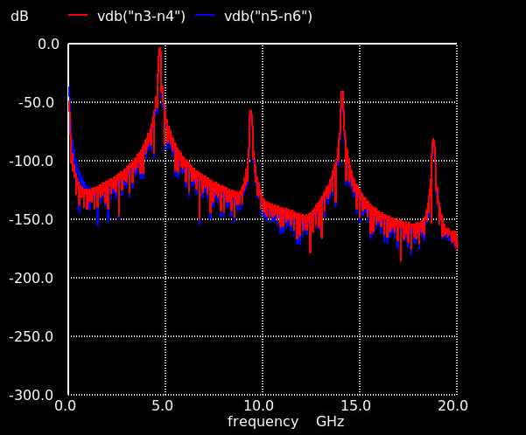
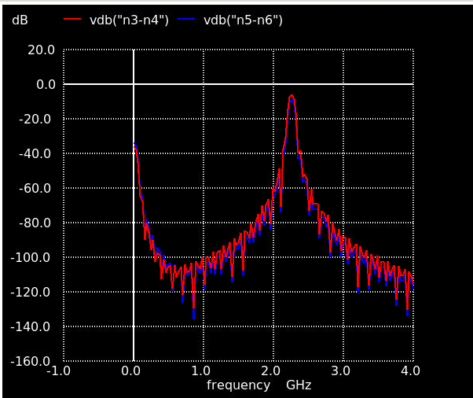
Other frequency
Input bits | frequency | Input bits | frequency
00000 | 9.734GHz | 10000 | 2.921GHz
00001 | 8.31GHz | 10001 | 2.78GHz
00010 | 7.36GHz | 10010 | 2.64GHz
00011 | 6.6GHz | 10011 | 2.54GHz
00100 | 6.12GHz | 10100 | 2.432GHz
00101 | 5.81GHz | 10101 | 2.349GHz
00110 | 4.86GHz | 10110 | 2.27GHz
00111 | 4.729GHz | 10111 | 2.16GHz
01000 | 4.49GHz | 11000 | 2.11GHz
01001 | 4.205GHz | 11001 | 2.054GHz
01010 | 3.95GHz | 11010 | 1.98GHz
01011 | 3.685GHz | 11011 | 1.89GHz
01100 | 3.504GHz | 11100 | 1.84GHz
01101 | 3.301GHz | 11101 | 1.79GHz
01110 | 3.124GHz | 11110 | 1.73GHz
01111 | 2.80GHz | 11111 | 1.71GHz

Slide 18
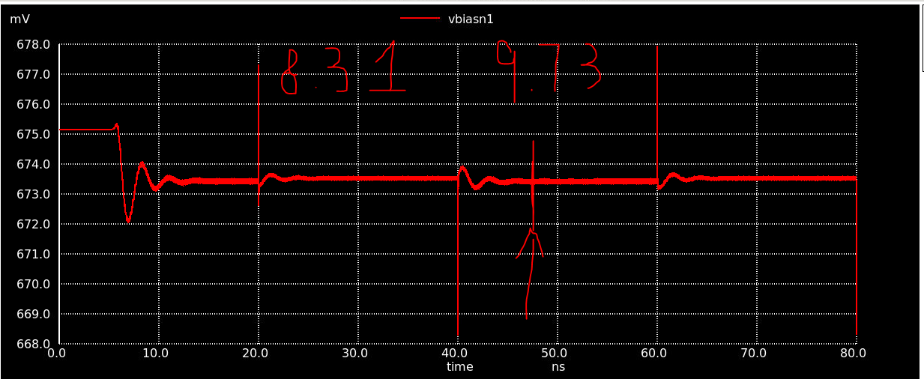
Setting time for shifting frequency
use vbiasn1 settling time as the settling time of the system
9.374G/0.3V sample settling plot
Frequency/ amp ctrl voltage | setlling time at vbiasn1
9.734G/0.3V | 6ns
9.734G/0.35V | 6ns
9.734G/0.4V | 5ns
4.86G/0.3V | 9ns
4.86G/0.35V | 6ns
4.86G/0.4V | 5ns
1.71G/0.3V | 6ns
1.71G/0.35V | 5ns
1.71G/0.4V | 4ns

Slide 19
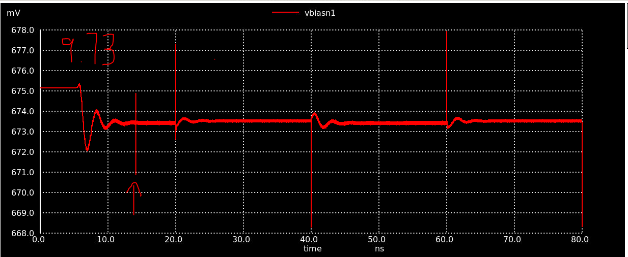
Power on settling time
use vbiasn1 settling time as the settling time of the system
9.73G/0.3V sample power on plot
Frequency/ amp ctrl voltage | setlling time at vbiasn1
9.734G/0.3V | 14ns
9.734G/0.35V | 11ns
9.734G/0.4V | 10ns
4.86G/0.3V | 22ns
4.86G/0.35V | 27ns
4.86G/0.4V | 17.4ns
1.71G/0.3V | 48ns
1.71G/0.35V | 35ns
1.71G/0.4V | 41ns

Slide 20
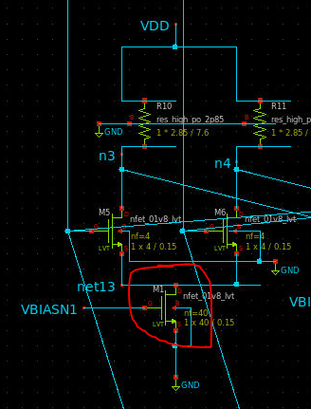
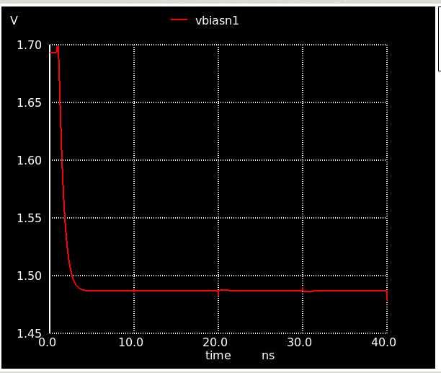
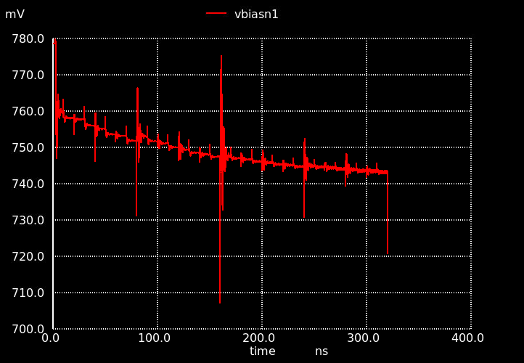
Resistor and current limitation
Maximum nominal vbiasn1 voltage: 760mV (1.113mA)
Resistor W = 2.85 => max 1.425mA
Positive feedback vbiasn1 voltage: 1.47V (2.2mA)
current read from op sim

Slide 21
Conclusion
Frequency range: 9.73GHz~1.71GHz
Amplitute control: 0.2~0.5V differential
second harmonic (best case): -60dB
third harmonic (best case): -60dB
settling time:6ns(max)
startup time:48ns(max)

Slide 22
Improment directions
Append a large swing op-amp to amplifier the output to a larger voltage
Retune capacitor bank to be smaller values to save capacitor budget.

